Slide 1
PHP Basics
Prepared By: Mary Grace G. Ventura ☺

Slide 2
PHP Scripting Block
Always starts with <?php and ends with ?>
<html>
<head><title>Hello World Script</title>
</head>
<body>
<?php
echo “<p>Hello World!</p>”
?>
</body>
</html>

Slide 3
Using Simple Statements
Simple statements are an instruction to PHP to do one simple action.
There are two basic statements to output text with PHP: echo and print.
Note: The file must have a .php extension. If the file has a .html extension, the PHP code will not be executed.

Slide 4
echo command
The simplest use of echo is to print a string as argument, for example:
echo “This will print in the user’s browser window.”;
Or equivalently
echo(“This will print in the user’s browser window.”);

Slide 5
Echo Statement
You can also give multiple arguments to the unparenthesized version of echo, separated by commas, as in:
echo “This will print in the “,
“user’s browser window.”;

Slide 6
PHP Simple Statements Follow These Rules:
PHP statements end with a semicolon or the PHP ending tag.
PHP doesn’t notice white space or the end of lines. It continues reading a statement until it encounters a semicolon or the PHP closing tag, no matter how many lines the statement spans.
PHP statements may be written in either upper- or lowercase.
In an echo statement, Echo, echo, ECHO, and eCHo are all the same to PHP.

Slide 7
Comments in PHP
In PHP, we use // to make a single-line comment or /* and */ to make a large comment block.
<?php //This is a line comment
# or this one /* This is a comment block */
?>

Slide 8
Variables
Are used for storing values such as numbers and strings so that it can be used several times in the script. “Symbolic Representation of a value”.
Variables are identified and defined by prefixing their name with a dollar sign
Example: $variable1, $variable2
Variable names must start with a letter or underscore character (“_”)
Variable names may contain letters, numbers, underscores, or dashes. There should be no spaces
Variable names are CaSE- SeNSiTiVE
$thisVar
$ThisvAr

Slide 9
Example of Variable Names
$item
$Item
$myVariable (camel case)
$this_variable
$this-variable
$product3
$_book
$__bookPage

Slide 10
Variables
PHP variables are not declared explicitly instead they are declared automatically the first time they are used.
It’s a loosely typed of language so we do not specify the data type of the variable.
PHP automatically converts the variable to the correct data type such as string, integer or floating point numbers.

Slide 11
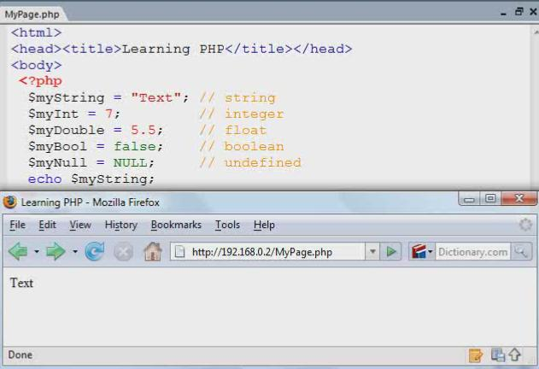
Illustration of a Variable Declaration

Slide 12
Example of Variable Variables
$varName=“ace”;
$$varName=1029;
//This is exactly equivalent to
$ace=1029;

Slide 13
Constants
Always stay the same once defined
Constants are defined with the define() function.
Example: define(“VARIABLE1”, “value”);
Constant names follow the same rules as variable names
Constants are typically named all in UPPERCASE but do not have to be.

Slide 14
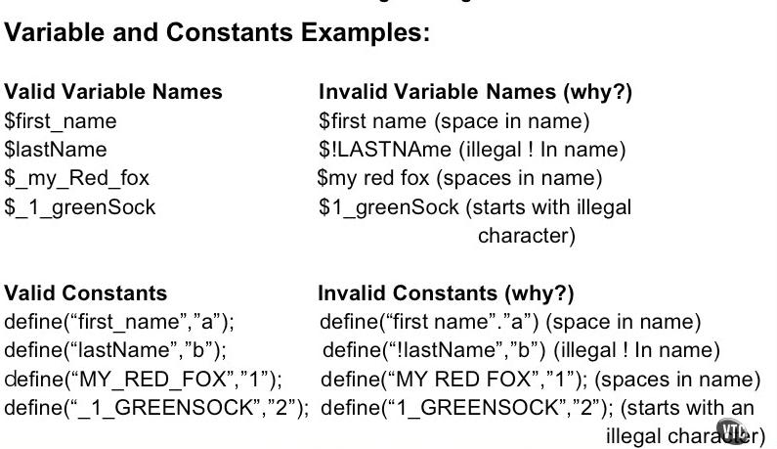
Variables and Constants Ex:

Slide 15
Constants
One important difference between constants and variables is that when you refer to a constant, it does not have a dollar sign in front of it.
If you want to use the value of a constant, use its name only.
define(‘OILPRICE’,10);
echo OILPRICE;

Slide 16
Sample Program for Constant Declaration
<?php
define(“USER”,”Grace”);
echo “Welcome ” . USER;
?>
Output:
Welcome Grace

Slide 17
Integer
Integers can be assigned to variables, or they can be used in expressions, like so:
$int_var = 12345;

Slide 18
Floating Point
Floating point numbers may be specified using either decimal or scientific notation.
Ex: $temperature = 56.89;

Slide 19
Doubles
Doubles are floating-point numbers, such as:
$first_double = 123.456;
$second_double = 0.456
$even_double = 2.0;
Note that the fact that $even_double is a “round” number does not make it an integer. And the result of:
$five = $even_double + 3;
is a double, not an integer, even if it prints as 5. In almost all situations, however, you should feel free to mix doubles and integers in mathematical expressions, and let PHP sort out the typing.

Slide 20
Boolean
The simplest variable type in PHP, a Boolean variable simply specifies a true or false value.
TRUE=1, FALSE=0
Case-Insensitive
True, TRUE, true are all the same.
Printing out Boolean values.
echo true . “\n”; //prints true
echo false; //(none)
1
(none)

Slide 21
Boolean
The ff. are considered FALSE:
Integers and floats zero(0)
Empty String (“”)
The string “0”
Array with zero elements
NULL
Object with zero member variables
Every other value is considered TRUE.

Slide 22
NULL
Null is a special value that indicates no value.
Case-insensitive
NULL, null, Null
NULL converts to boolean FALSE and integer zero.
A variable is considered to be NULL if:
It has been assigned to the constant NULL
It has not been set to any value yet
It has been unset
<?php
$a= NULL;
echo $a; ?>

Slide 23
isset(), is_null()
isset()
Tests if a variable exists
Returns FALSE if:
Is set to NULL
Variable has been unset()
is_null()
Determines if the given variable is set to NULL.
Returns true if variable is NULL, FALSE otherwise.

Slide 24
empty()
Determines if a variable is empty.
The following values are considered empty:
Value | Description
“ ” | Empty String
0 | Zero
“0” | Zero as string
NULL | Null value
FALSE | Boolean

Slide 25
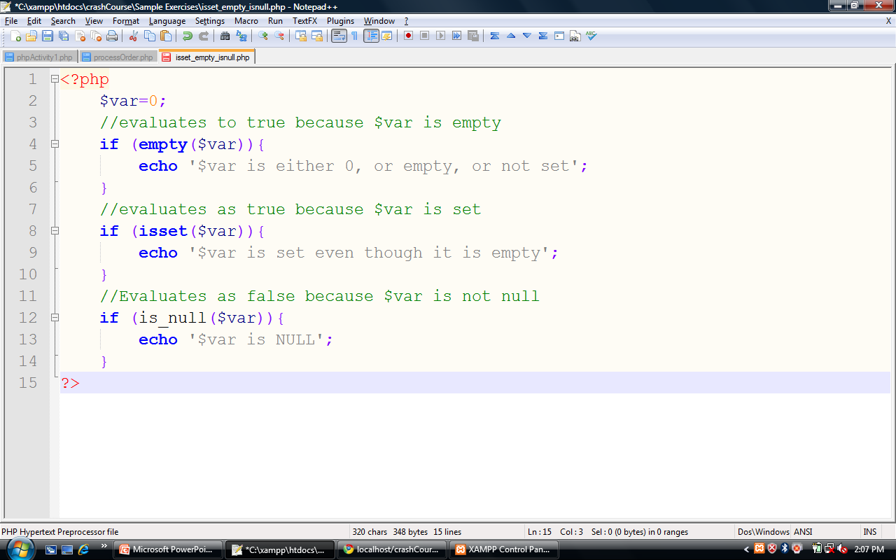
isset() vs empty() vs is_null()

Slide 26
Strings
A string is a sequence of characters, like 'hello' or 'abracadabra'. String values may be enclosed in either double quotes ("") or single quotes ('').
$name1 = “Ervin”;
$name2 = ‘Grace’;

Slide 27
Singly Quoted Strings
Except for a couple of specially interpreted character sequences, singly quoted strings read in and store their characters literally.
$literally = ‘My $variable will not print!\\n’;
print($literally);
produces the browser output:
My $variable will not print!\\n

Slide 28
Doubly Quoted Strings
Strings that are delimited by double quotes (as in “this”) are preprocessed in both the following two ways by PHP:
Certain character sequences beginning with backslash (\) are replaced with special characters.
Variable names (starting with $) are replaced with string representations of their values.

Slide 29
Escape Sequence Replacements Are:
\n is replaced by the new line character
\t is replaced by the tab character
\$ is replaced by the dollar sign itself ($)
\” is replaced by a single double-quote (“)
\\ is replaced by a single backslash (\

Slide 30
A Note on String Values
<?php
$identity = 'James Bond';
$car = 'BMW';
// this would contain the string
// "James Bond drives a BMW"
$sentence = "$identity drives a $car";
// this would contain the string
// "$identity drives a $car"
$sentence = '$identity drives a $car';
?>

Slide 31
A Note on String Values
<?php
// will cause an error due to
// mismatched quotes
$statement = 'It's hot outside';
// will be fine
$statement = 'It\'s hot outside';
?>

Slide 32
Data Conversion
In PHP, the type of the variable depends on the value assigned to it.
<?php $foo = “0”; //$foo is string $foo += 2; // $foo is an integer $foo = $foo + 1.3; // $foo is now a float $foo = 5 + “10 Piggies”; //$foo is an integer (15)

Slide 33
Typecasting
There are circumstances in which you will want to control how and when individual variables are converted from one type to another.
This is called typecasting
Typecasting forces a variable to be evaluated as another type
The name of the desired type is written in parentheses before the variable that is to be cast.

Slide 34
Typecasting-Integers
You can typecast any variable to an integer using the (int) operator.
Floats are truncated so that only their integer portion is maintained.
echo (int) 99.99; //99
Booleans are cast to either one or zero
(int) TRUE == 1
(int) FALSE == 0
Strings are converted to their integer equivalent
echo (int) “test 123” ; //0
echo (int) “123”; //123
echo (int) “123test”; //123
NULL always evaluates to zero.

Slide 35
Typecasting Booleans
Data is cast to Boolean using the (bool) operator
echo (bool) “1”;
Numeric values are always TRUE unless they evaluate to zero
Strings are always TRUE unless they are empty
(bool) “FALSE” ==true
Null always evaluates to FALSE.

Slide 36
Typecasting- Strings
Data is typecast to a string using the (string) operator:
echo (string) 123;
Numeric values are converted to their decimal string equivalent:
(string) 123.1 == “123.1”;
Booleans evaluate to either “1” (TRUE) or an empty string (FALSE)
NULL values evaluates to an empty string.

Slide 37
Gettype()
Gets the type of a variable
Returns “boolean”, “integer”, “double”, “string”, “array”, “object”, “resource”, “NULL”.
<?php $foo = 2.5; //$foo is a float $bar =(int) $foo+1; // $bar is an int (3) //outputs: $bar=3, type:integer echo ‘$bar = ‘.$bar. “, type: “ .gettype($bar); //outputs: $foo= 2.5, type: double echo ‘$foo = ‘ . $foo . “, type: “.gettype($foo);

Slide 38
settype()
Sets the type of a variable
“boolean”, “integer”, “double”, “string”, “array”, “object”, “resource”, “NULL”
<?php $foo= 2.0; //$foo is a float settype($foo, “integer”); //$foo is an int $bar =$foo + 1; // $bar is an int (3) //outputs: $bar =3, type: integer echo ‘$bar = ‘ .$bar . “,type: “ . gettype($bar); //Outputs: $foo=2, type: integer echo ‘$foo = ‘ . $foo . “,type: “ . gettype($foo); ?>

